Slide 1
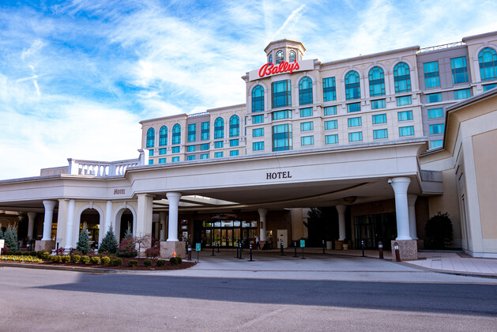
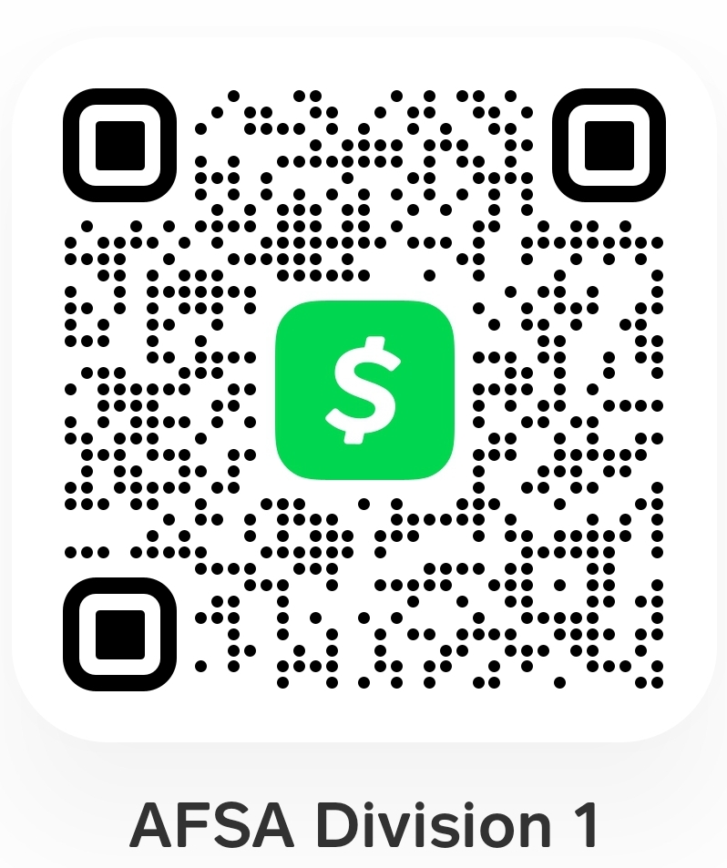
2024 AFSA Division 1 Conference,
Professional Development Symposium,
& Reunion
Meet and Hear From Keynote Speaker:
CMSAF #11, Dave Campanale!
Bally’s Dover Casino Resort
1131 N Dupont Hwy, Dover, DE 19901
30 Apr – 2 May 2024
Full Registration – $239
Includes all meals (by Royal Prime Events, as shown below), refreshments, entertainment, commemorative conference magazine, seating, and welcome bag!
(Professional Development/Business Sessions are free)
Separate Meals (catered by Royal Prime Events) Available as follows:
Theme Party – 30 Apr: $40
Opening Breakfast – 1 May: $25
President’s Dinner – 1 May: $50
Honors Banquet – 2 May: $75
All rates increase on 1 Apr, payment deadline is 16 Apr
This event is a professional development opportunity!
TDY is authorized and highly encouraged. In the event funds are not available, PTDY may be used.000,
Rooms reservations must be made at Bally’s w/code: GAFSA01
NLT 31 Mar to ensure rate of $99/night + fees
(availability not guaranteed after this date)
Visit Convention Tab at: www.afsadivision1.org for all forms; or
Contact: David McCoy at dmccoy1@hqafsa.org
CashApp
Must include:
Name & Event!

